Slide 1
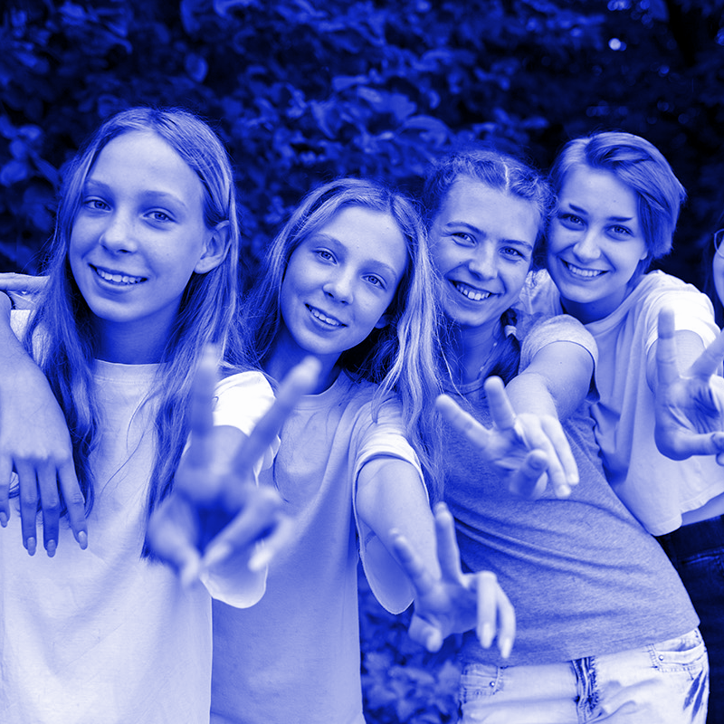
Customer Segmentation
Texting App Pitch Deck
EXPOSYS PROJECT
Write your message

Slide 2
Table of contents
01
02
03
04
Introduction
Existing Method
Proposed method
Methodology

Slide 3
Table of contents
05
06
Implementation
Conclusion
Methodology

Slide 4
Introduction
Customer Segmentation Project
Clustering could be a measurable procedure much similar to classification.
It sorts crude information into important clusters and groups of moderately homogeneous perceptions.
The grouping is finished by finding similitudes among data according to characteristics found in crude information.
The main objective was to discover ideal number of clusters. There are two fundamental sorts of clustering strategies, progressive and non-hierarchical.
Clustering maybe sort of explorative datamining utilized in numerous application situated regions such as machine learning, classification and design.
11:25 AM
Write your message

Slide 5
Customer Segmentation
PROPOSED SYSTEM
The data set for clustering and the K-means technique was obtained from a shopping center store.
The data collection has five attributes and 200 tuples, which represent the information of 200 customers.
CustomerId, gender, age, annual income (k$), and expenditure score on a scale of 1-10 are among the attributes in the data collection (1-100).

Slide 6
Customer Segmentation Project
EXISTING SYSTEMS
Projects were already developed using a direct approach by segmenting customers based on customerID, gender, age and behaviouristic characters.
Current trend has made it unclear for prediction as machine learning and deep learning techniques aren’t being used that actually have a capacity to give an outstanding prediction.
Our current technology has all those features that can bypass these flaws with the help of
k-means and clustering which are a part of data analytics and machine learning.

Slide 7
METHODOLOGY
Customer Segmentation Project
The informational index used to execute
bunching and K Means calculation was
gathered from a store in the shopping center.0
The data set contains 5 attributes and has 200 tuples, addressing the information of 200 clients.
The attributes in the dataset has CustomerId, gender, age, yearly income(k$),spending score on the size of (1-100).

Slide 8
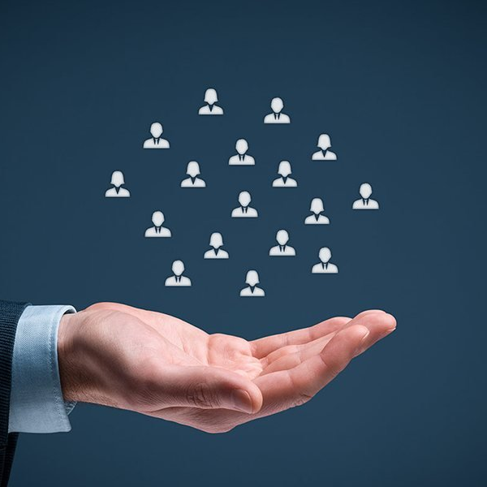
Implementation
Texting App Pitch Deck
11:25 AM
Client segmentation is the practice of dividing a customer base into many groups of people who are similar in many aspects significant to marketing, such as gender, age, hobbies, and other spending patterns.
Write your message

Slide 9
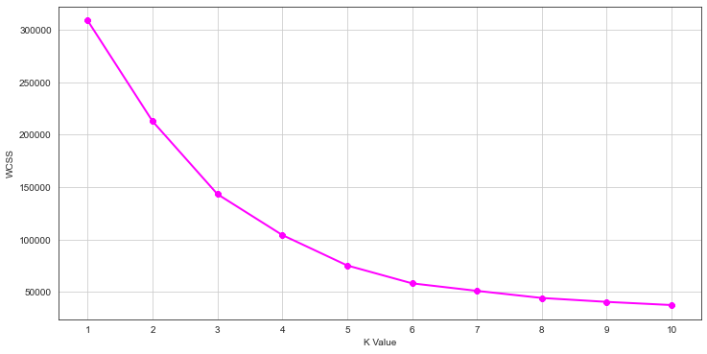
Using the Elbow Method
Customer Segmentation Project
The plot means the estimated number of clusters needed in our model.
The ideal clusters can be found from the diagram where there is a bend in the chart

Slide 10
Implementation
GOALS OF THE PROJECT:
Companies want to obtain a better understanding of the customers they're after.
As a result, their goal must be particular and designed to meet the needs of each and every unique consumer.
businesses may acquire a better grasp of client preferences as well as the needs.

Slide 11
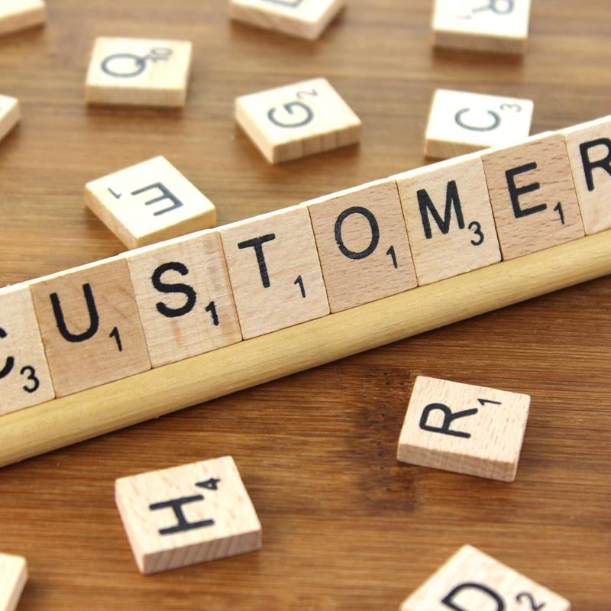
Conculsion
Customer Segmentation
11:25 AM
We looked through the client segmentation model in this data science assignment.
Supervised learning was the process through which we created our machine learning model.
We used a clustering approach called K-means clustering in particular. We evaluated and displayed the data before putting our system into action
Write your message

Slide 12


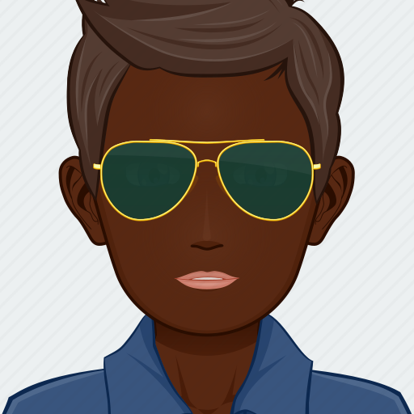

Meet our team
MUKUL RAYANA
3rd SEMESTER B.TECH
aimukulrayana@gmail.com
Artificial Intelligence & Data Science Easwari Engineering College
ANIL KUMAR D
3rd SEMESTER B.TECH
anilkumar220601@gmail.com
Artificial Intelligence & Data Science Easwari Engineering College
KANISHKAA R
3rd SEMESTER B.TECH
aikaniskaa01@gmail.com
Artificial Intelligence & Data Science Easwari Engineering College
HARISH RANGASAMY
3rd SEMESTER B.TECH
anilkumar220601@gmail.com
Artificial Intelligence & Data Science Easwari Engineering College

Slide 13
THANK YOU!
Customer Segmentation Project
Hope you liked our presentation!
Write your message

